Slide 1
JalVaahini:
A product of AMAR Auto-Agricultural Solutions
DATE: 08/02/2022 NAME: TEAM AMAR
EMAIL: info@amaraas.com
PHONE: +91 99999 99999
ORGANISATION: AMAR AUTO-AGRICULTURAL SOLUTIONS
LOCATION: Nagpur

Slide 2
About our Company
India is a global agricultural powerhouse but agriculture accounted for only 20.2% of total GDP of around 2.6 trillion USD. Some of the reasons can be attributed to mass production being resource intensive, increase in drought due to climate change, soil degradation,etc. By applying technology, we can address many agricultural problems
Our company will make products to bring automation in agriculture in order to ease agricultural practices and technology based products to make judicial use of resources in order to make agriculture profitable, sustainable and scalable.

Slide 3
Elevator pitch
We are developing a rover which will be used to install online irrigation system specifically to punch the holes in the tubes and to install the drippers. Traditionally this process requires manual work by farmers to punch holes and install the drippers which lead to pains to farmers.
The rover will be using camera to detect the target sites followed by punching holes and installing drippers. it is first such automated solution which will be maintaining the uniform rate all over with the farmers involved in horticulture as our primary customers.

Slide 4
Team
Founding team
Name | Qualifications | Experience Summary | Key Skills | Commitment (Part-time/full time)
Anurag Maldhure | Engineering Undergraduate | Worked on Projects | Robotics, Electronics, Mechanics, Critical thinking | Part time
Mahima Dhurve | Engineering Undergraduate | Worked on Projects | CAD Designing, Robotics, Farming, Automation | Part time
Akash Zalke Rutika Warade | Engineering Undergraduate Engineering Undergraduate | Worked on Projects Worked on Projects | Programming, Logic building, Software Developer Programming, Electronics, Strategic Planning | Part time Part time

Slide 5
Solution/ Technology
The rover that we will develop would automate the process of laying down lateral pipelines connected to the sub main pipeline and the process of punching a hole and inserting the drippers at distant points near the roots of trees on the lateral pipeline
The camera onboard on rover will help detect monochromatic colour bands placed at the target dripper sites using computer vision and the navigation will be partially controlled by programmed rover & partially by Farmer’s input using a easy to use smartphone application

Slide 6
Problem/ Opportunity
For installation of Online drip irrigation farmer have to punch hole and install drippers manually . This work is quite tedious and it lead to back-pain and knee pain due to frequent sitting and standing. Also, while punching the holes the farmers may hurt their fingers.
Installation of Drip Irrigation is complex task so many farmers depend on suppliers for installation which charge them heavily .
Rates of installation of drip irrigation vary region wise so we can act as a centralized authority and provide service at minimal rates

Slide 7
Current Status/ Stage
Prototype is under development and the rover is the first automated project in its type.
So the product is not yet in to the market with the status being in the prototyping stage(idea, design ready).

Slide 8
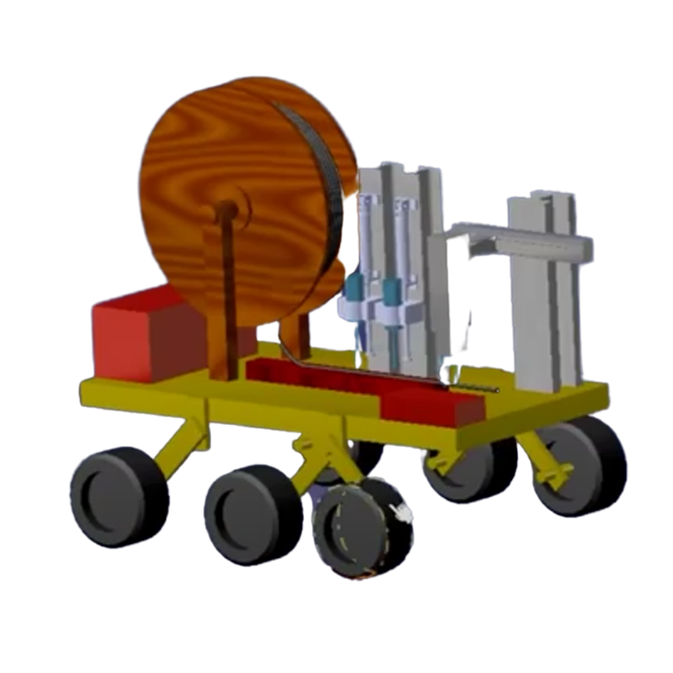
Product demo

Slide 9
Unique Value proposition
First of its kind automated solution offered for Online Drip Irrigation Installation
Uniformity in providing service at a bare minimal rates

Slide 10
Customer Segments & Market Size
Farmers from horticulture who use online drip irrigation system to irrigate their land are basically our customers.
10 lakhs of farmers directly involved in horticulture in India with fruits giving production of nearly 100.45 Million Tonne in area of 6.70 Million Hectare, for vegetables the production is average 18.4 Million Tonnes in area of 10.32 Million Hectares, with India being second largest in production of fruits like mango, papaya, lemon.

Slide 11
Channels
Initially to Farmers in the reach (Service based offer)
We shall pay some small commission to local suppliers for our reference and some discounts to farmers for reference
Suppliers of irrigation systems (Product offered for sale - After our startup is scaled up enough)
Farmers’ Community (Product offered for sale - After our startup is scaled up enough)

Slide 12
Costs
Cost for manually installing drippers by workers is around INR 2000 - 2500 per acre
We will charge only for service (automatic installation) which will be lesser than Manual Cost
The operation cost, the wages to be paid to the agent, transport chargers will also be included in the cost of the product.

Slide 13
Revenue Model
Initially we will provide our rover to currently established suppliers and generate revenue through commission basis
After Scaling up enough we will provide direct services to farmers by that time we will also have enough customer database

